Slide 1
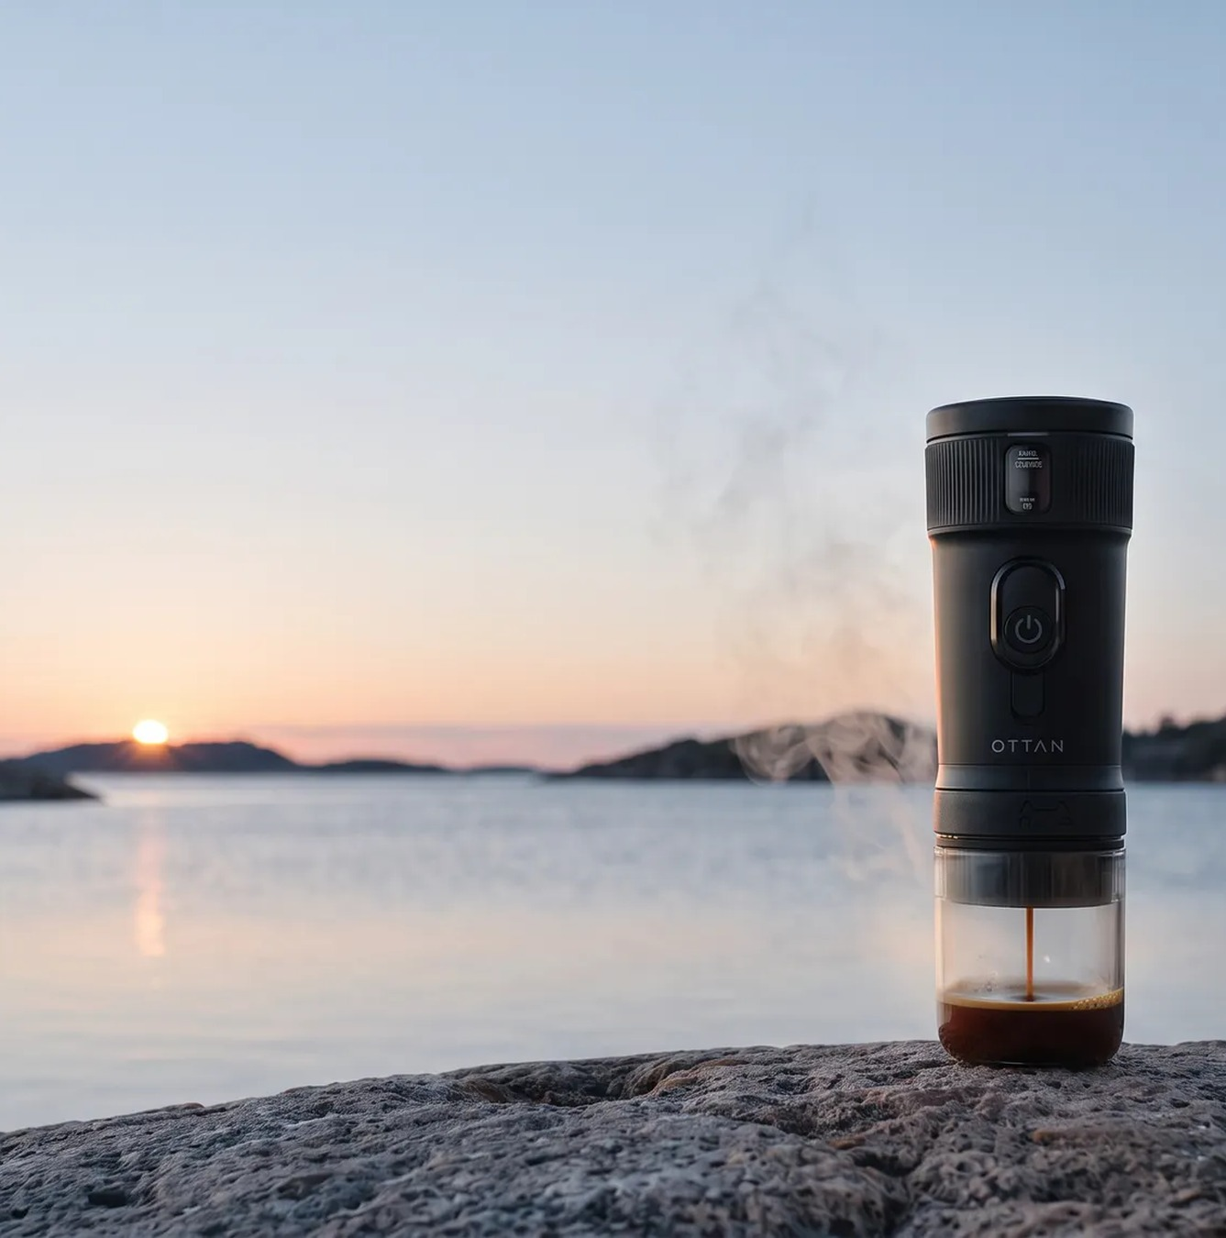

PARTNER PRESENTATION · SWEDEN
Freshly brewed. Anywhere.
OTTAN NORD · RETAIL AND DISTRIBUTION PARTNERS

Slide 2
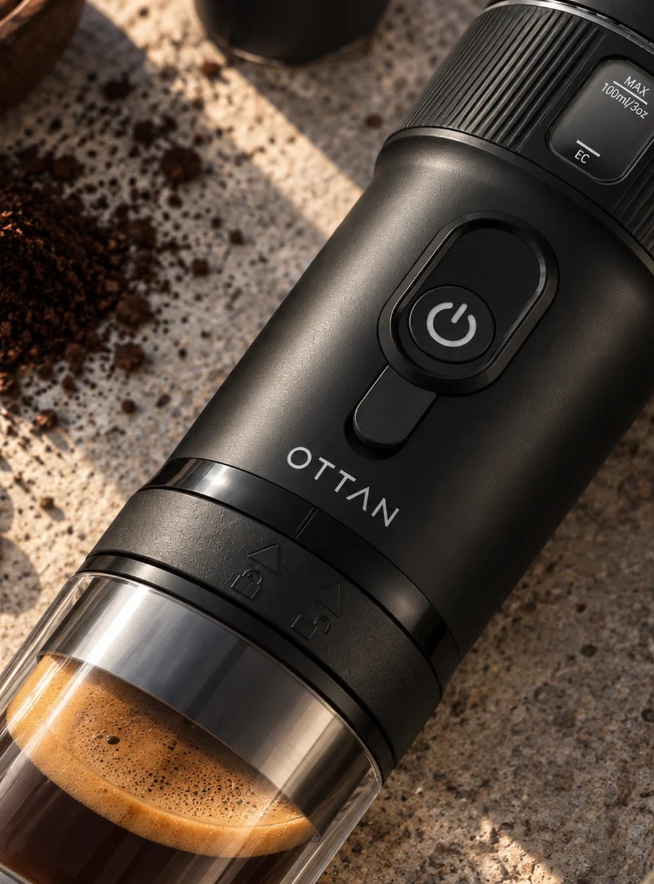

THE NAME
OTTAN is the moment the day begins
A Swedish word for the early morning hours, when the world wakes and the day takes shape.
OTTAN takes that moment beyond the kitchen with self-heated espresso for everyday life, travel and the outdoors.
02 / 22

Slide 3
MARKET SIGNAL
The coffee habit is already there
The opportunity is to create more occasions to drink it well.
8 / 10
1,000+
SWEDES DRINK COFFEE REGULARLY
CUPS PER PERSON PER YEAR
SOURCE: LÖFBERGS COFFEE REPORT 2025/2026
03 / 22

Slide 4
CONSUMER TREND
Quality coffee is becoming a lifestyle
International data points toward higher quality, espresso and more occasions beyond the kitchen.
47%
69%
DRANK BARISTA-QUALITY COFFEE IN THE PAST DAY
OF 25–39-YEAR-OLDS DRANK IT IN THE PAST WEEK
SOURCE: SPECIALTY COFFEE ASSOCIATION / NCA 2026. US DATA USED AS AN INTERNATIONAL TREND INDICATOR.
04 / 22

Slide 5
EUROPEAN MARKET
Western Europe leads the category
Strong espresso culture and everyday mobility make the region a natural launch market.
$38.47m
≈26%
$34.19m
SHARE OF THE GLOBAL MARKET
WESTERN EUROPE · 2024
NORTH AMERICA · 2024
SOURCE: FACT.MR, PORTABLE ESPRESSO MACHINES MARKET, 2025
05 / 22

Slide 6
CATEGORY GROWTH
Market value is expected to nearly double
Global portable espresso machine market value, 2024 to 2034.
$290.9m
6.9%
ANNUAL VALUE GROWTH
$149.3m
2024
2034
SOURCE: FACT.MR, PORTABLE ESPRESSO MACHINES MARKET, 2025
06 / 22

Slide 7
COMPETITION LANDSCAPE
Three product models. One clear direction.
Nord follows the cordless, self-heating model that works across home, work, travel and the outdoors.
01
02
03
MANUAL
VEHICLE-POWERED
BATTERY-POWERED
Hand-pumped · Requires hot water · No charging
12V connection · Heats water · Primarily designed for the car
Cold or hot water · Cordless · Built for many occasions
REPRESENTATIVE CATEGORY MODELS DESCRIBE USE CASES, NOT MARKET SHARE.
07 / 22

Slide 8
THE BRAND
A coffee brand built for life in motion
OTTAN brings together coffee culture, Scandinavian design and smart mobility in a new lifestyle format.
01
02
03
BARISTA QUALITY
DESIGNED TO MOVE
A BRAND
Where life happens.
With you.
Not a gadget.
Founded in Gothenburg, Sweden.
08 / 22

Slide 9
TARGET GROUP
Defined by occasion. Not by age.
THE COMMUTER
Between home, work and everyday routines.
THE ACTIVE PARENT
At training, matches and activities.
THE TRAVELLER
Hotels, road trips, airports and destinations.
THE OUTDOOR CONSUMER
Hiking, camping, boating and leisure.
One shared need: great coffee where a traditional machine is not available.
09 / 22

Slide 10
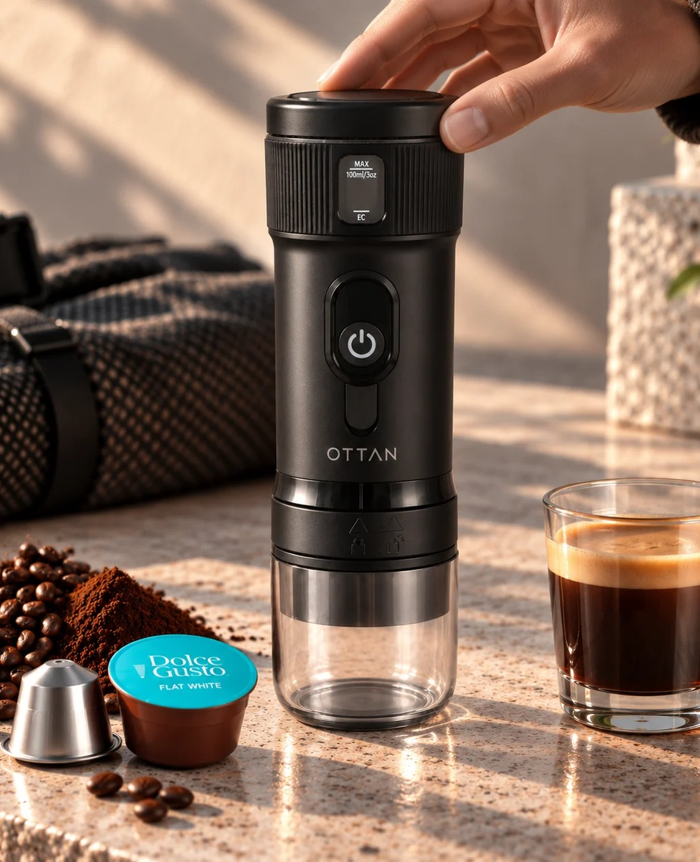
THE PRODUCT
Three formats. One machine.
Portable. Self-heating. Battery-powered.
01
Nespresso-format
For the quick, familiar capsule routine.
02
Dolce Gusto
A broader selection and more flexibility.
03
Ground coffee
For those who want to choose their own beans.
10 / 22

Slide 11

CONSUMER NEED
Great coffee on your own terms
Consumers move between commuting, work, training, travel and the outdoors. The coffee experience rarely follows.
OTTAN Nord turns espresso into a personal product rather than a location-bound appliance.
11 / 22

Slide 12
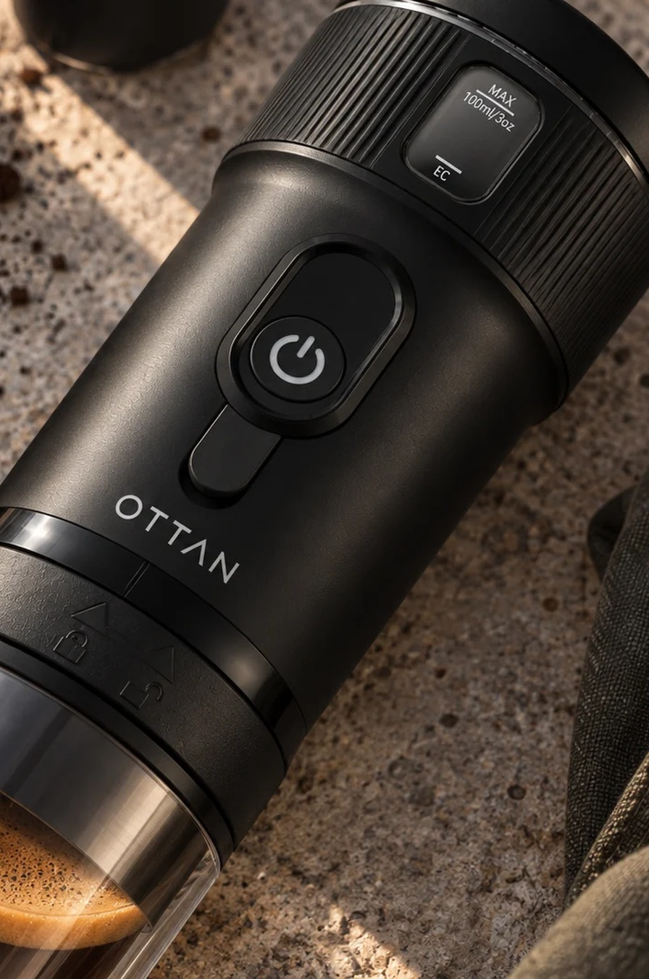
PERFORMANCE
Built for real espresso on the move
92°C
20 BAR
WATER HEATING · EXTRACTION AT APPROXIMATELY 80–85°C
PUMP PRESSURE
2600 mAh 28wh
≈5 MIN
BATTERY CAPACITY
COLD-WATER HEATING
4 / 200
CUPS WITH COLD / PRE-HEATED WATER
12 / 22

Slide 13
THE OPPORTUNITY
Nord connects three consumer forces
01
02
03
COFFEE
MOBILITY
CONSUMER TECHNOLOGY
A Swedish daily ritual
More occasions away from home
Battery power, USB-C and simple operation
A new usage category, not a smaller kitchen appliance.
13 / 22

Slide 14
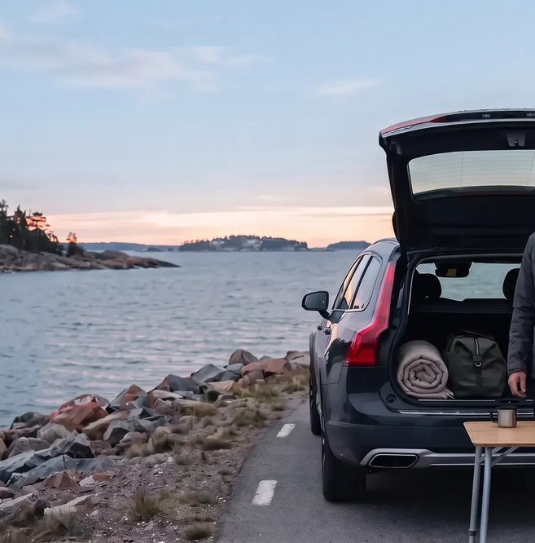
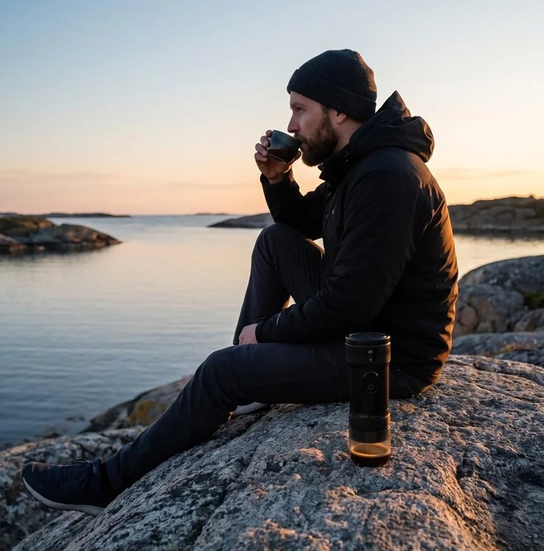
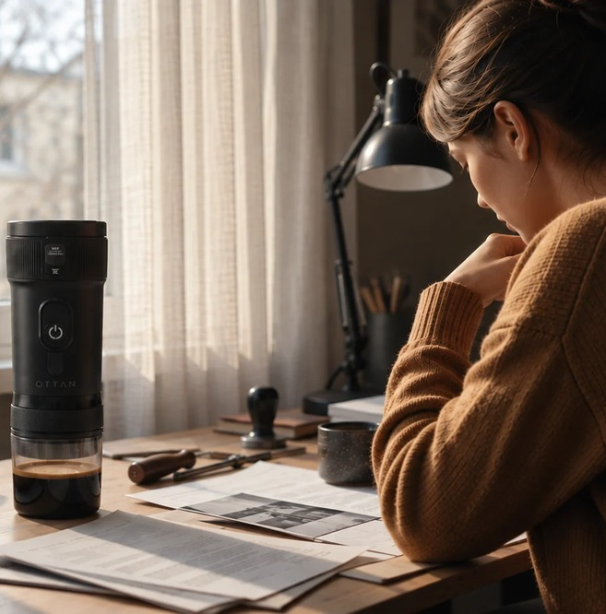
USE CASES
One product. Many routines.
SPORT AND LEISURE
OUTDOOR AND TRAVEL
WORK AND HOTELS
From the morning match to a forest break and the office.
14 / 22

Slide 15
THE OTTAN ESSENTIALS
Three essentials. One coffee ritual.
01
02
03
OTTAN GRIND
OTTAN HEAT
OTTAN DAWN
Freshly ground coffee, wherever the day starts.
A portable companion for the full ritual.
Recurring coffee built around the brand.
More occasions. Higher basket value. Recurring coffee sales.
15 / 22

Slide 16
CHANNEL STRATEGY
Focused launch. Controlled expansion.
Build brand visibility in selected channels first, then scale through distribution, repeat purchase and new use occasions.
LAUNCH
SELECTED RETAIL
Trust, visibility and demo-led sell-through.
LAUNCH
DISTRIBUTION PARTNERS
Market access, forecasting and retail execution.
ALWAYS ON
DTC
Brand control, consumer learning and accessories.
PHASE 2
TRAVEL AND HOSPITALITY
Expand occasions where portability matters.
Win selected accounts. Prove sell-through. Expand doors and markets.
16 / 22

Slide 17
COMMERCIAL OFFER
Clear margin from the first listing
SEK 1,199
SEK 576
≈40%
RRP INCLUDING VAT
RETAILER BUY PRICE EXCLUDING VAT
RETAILER MARGIN
RRP excluding VAT: SEK 959.20 · Gross profit per unit: SEK 383.20
17 / 22

Slide 18
COMMERCIAL LAUNCH AND SUPPORT
Built to create demand together
DIGITAL AND SOCIAL
Everyday life, travel, outdoor and coffee culture.
PR AND CREATORS
Relevant coffee, outdoor, travel and lifestyle voices.
RETAIL ACTIVATION
Product education, demo content and POS assets.
LOCAL PARTNERSHIP
Activities adapted to each market and key account.
OTTAN builds the brand. The partner opens the market. Together, we build sell-through.
18 / 22

Slide 19
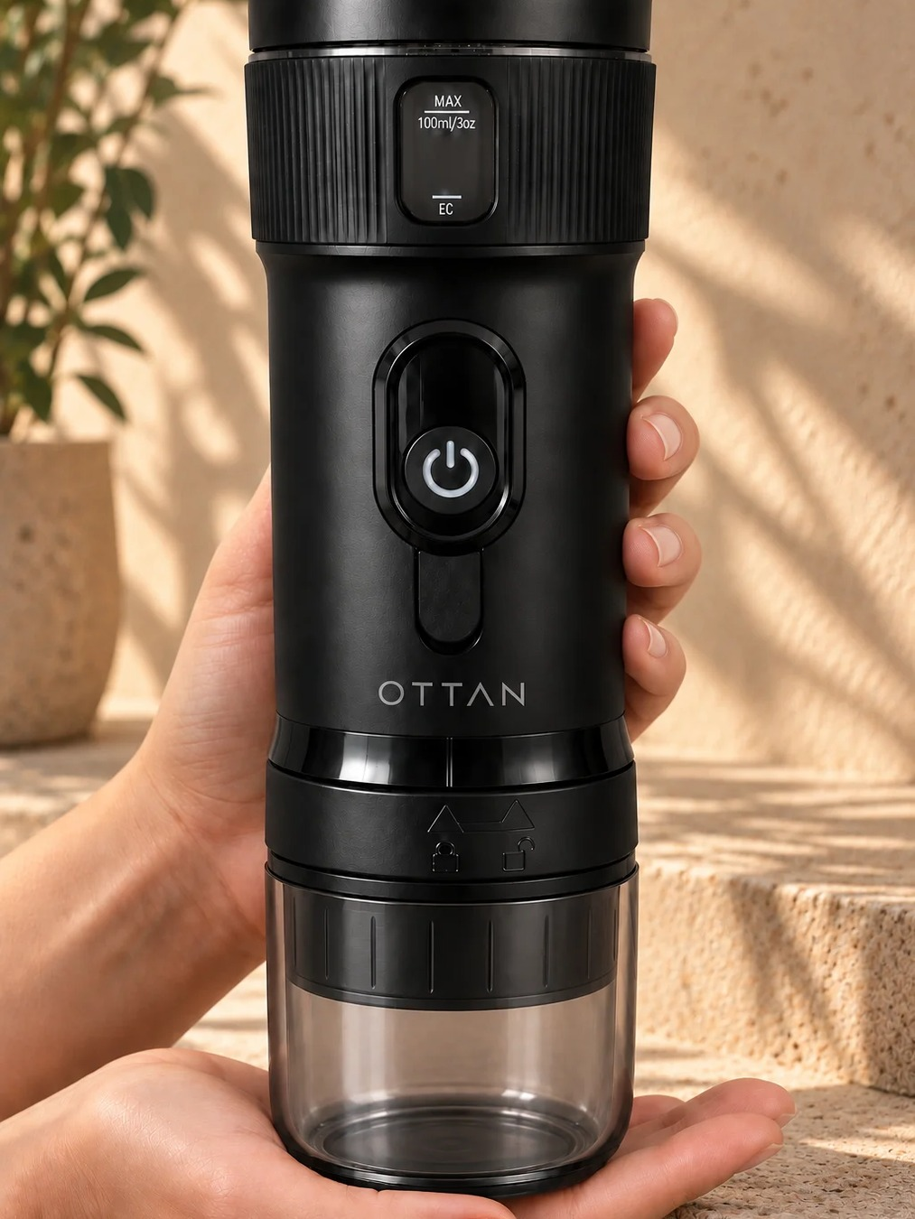
LAUNCH READINESS
Prepared for retail
✓
CE AND ROHS DOCUMENTATION
✓
UN38.3 AND MSDS CERTIFICATIONS
✓
PACKAGING CONCEPT
✓
PRODUCT AND LIFESTYLE ASSETS
✓
DEMO VIDEO FOR TRAINING AND SOCIAL
✓
INITIAL ORDER PLAN
500–1,000 units
19 / 22

Slide 20
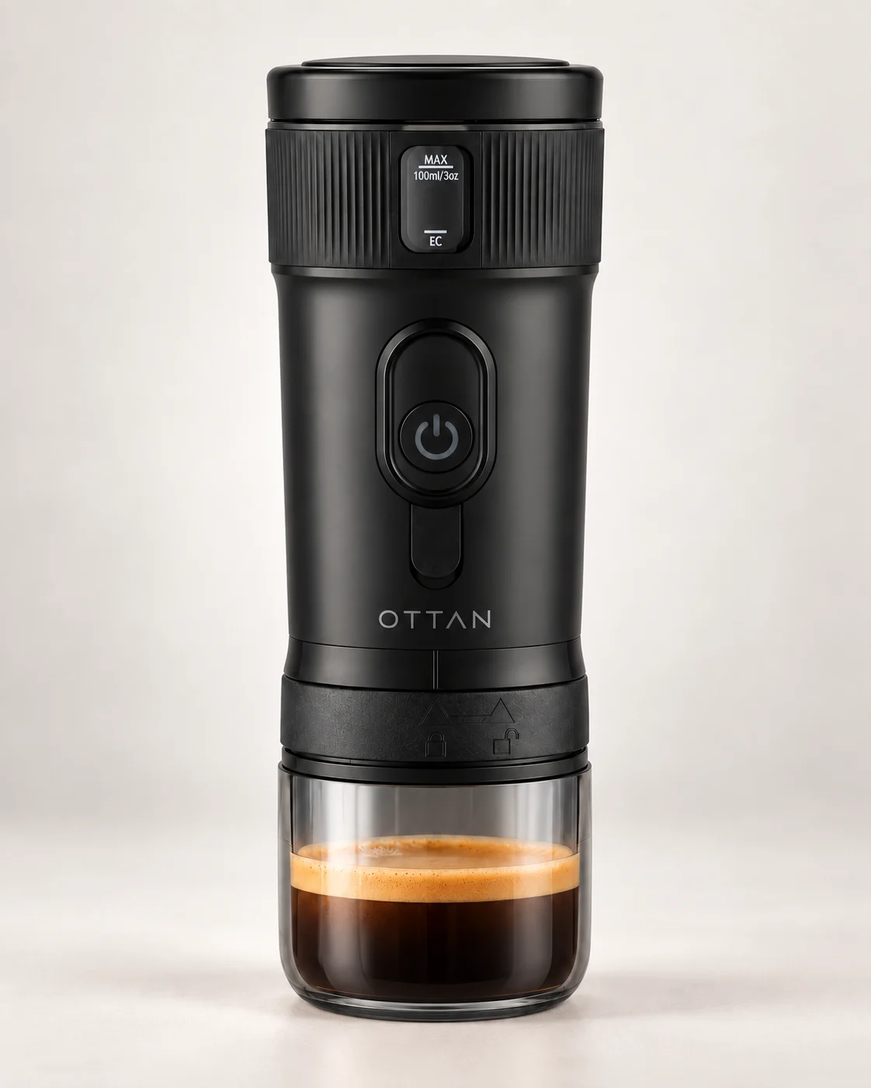
RETAIL PACKAGING
Packaging that works on the shelf
PREMIUM AT FIRST SIGHT
A black finish and clear OTTAN identity create shelf presence.
BENEFITS UP FRONT
Heating, battery, capacity and use are easy to understand.
DETAILS ON THE BACK
Brewing formats, specifications and certification markings.
PACKAGING CONCEPT. FINAL PRINT ARTWORK TO BE VERIFIED.
20 / 22

Slide 21
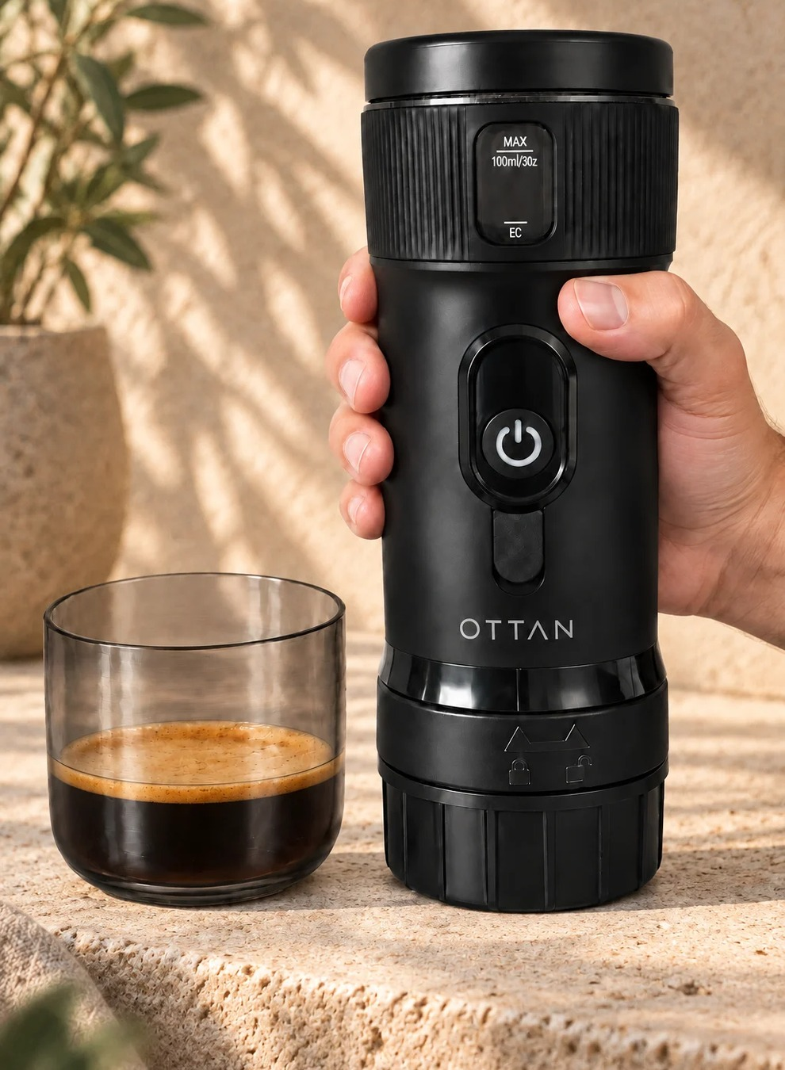
RETAIL ENVIRONMENT
Designed to stand out in store
CLEAR IDENTITY
EASY TO DEMONSTRATE
Premium Scandinavian design with high perceived value.
A compact footprint and a product story shoppers understand.
CROSS-SELLING POTENTIAL
FLEXIBLE EXECUTION
Coffee, accessories, gifting, travel and leisure.
Display and messaging adapt to the retailer’s format.
21 / 22

Slide 22

RETAIL PARTNERS
Let’s take real coffee to more places
We are looking for selected distributors and retail partners for launch, demonstration and long-term category development.
Nino Titoric · +46 73 511 41 01 · nino@ottanlife.com

